Slide 1

Can LLMs Quantify Market Reactions to Financial News and Regulation?
Songyi Huang, Jiayu Zhao, Yicheng Liu
Presented by Group28
Mar 3, 2026
Data Analytics and Visualization for PublicPolicy
1 / 8

Slide 2
Introduction
Motivation
Financial regulators such as the SEC, FDIC, and the Federal Reserve closely monitor market stability, yet it remains difficult to measure how quickly and intensely financial markets react to regulatory announcements and news events.
We ask 3 Questions
1. Can sentiment scores derived from Large Language Models (LLMs) applied to financial news predict short-term volatility in regional bank stocks?
2. Do LLM-based sentiment indicators provide earlier or stronger signals of market instability than traditional market metrics such as historical volatility or trading volume?
3. Are market reactions to financial news and regulation geographically concentrated, affecting certain regions more than others?
Figure out how AI-based text analysis could support financial stability monitoring and regulatory decision-making
Data Analytics and Visualization for PublicPolicy
2 / 8

Slide 3
Data
RAW DATA
1.Financial News & Regulatory Text Data
Daily financial headlines from Kaggle and other news partners, with timestamps and tickers.
Used to train a light sentiment classifier (positive / negative / neutral) and to build yearly indices of regulatory‑news sentiment.
2.Banking fundamentals (FDIC) Data
FDIC state‑level “Summary of Results” for commercial banks – financial.
State–year totals for assets, net income, number of banks, net interest margin (NIM), and related balance‑sheet items.
3.Geographic Data for Banks
U.S. Census TIGER/Line shapefiles for U.S. states (cb_2024_us_state_20m).
Provides state boundaries used to draw choropleth maps of banking stress.
Data Analytics and Visualization for Public Policy
3 / 8

Slide 4


Data
FDIC banking fundamentals data : ROA, ROE, Deposits etc
negative regulatory/banking regulation news ⮕NLP⮕sentiment index
1. Merge FDIC state-year banking fundamentals with yearly regulatory-news sentiment.
❶ ΔROA (Profitability Change)
Change in return on assets for state s from year t to t+1
❷ bad_year (Stress Indicator)
Binary indicator equal to 1 if ΔROA is unusually low
If ΔROA very low, bad_year = 1
❸ severity (Magnitude of Deterioration)
Continuous measure capturing how severe the profitability decline is (HOW bad it was)
❹ StressScore (Composite Stress Index)
StressScore = Probability of Distress × Severity of Distress
2.Visualization Outputs
Static scatter: regulatory‑news negativity vs. ΔROA across state–years.
Static map: state‑level StressScore
Data Analytics and Visualization for Public Policy
4 / 8

Slide 5
Method - Two‑Stage Prediction + Stress Score
​
Do Sentiment Variables Enhance Bank Stress Prediction?
​Model 1: Bank Stress ~ FDIC fundamentals
​Model 2: Bank Stress ~ FDIC fundamentals + News Sentiment
Model | AUC (Bad Year Prediction) | R² (Severity Prediction)
FDIC Fundamentals Only | 0.636 | -0.164
FDIC + News Sentiment | 0.646 | -0.126
AUC → The model's ability to distinguish between "stressed" and "normal" states.
R² → The model's ability to explain the extent of bank profitability deterioration.
Higher AUC = better classification
Higher R² = better regression fit
Adding regulatory-news sentiment slightly improves prediction performance, suggesting that news tone contains additional information about banking stress.
Data Analytics and Visualization for Public Policy
5 / 8

Slide 6
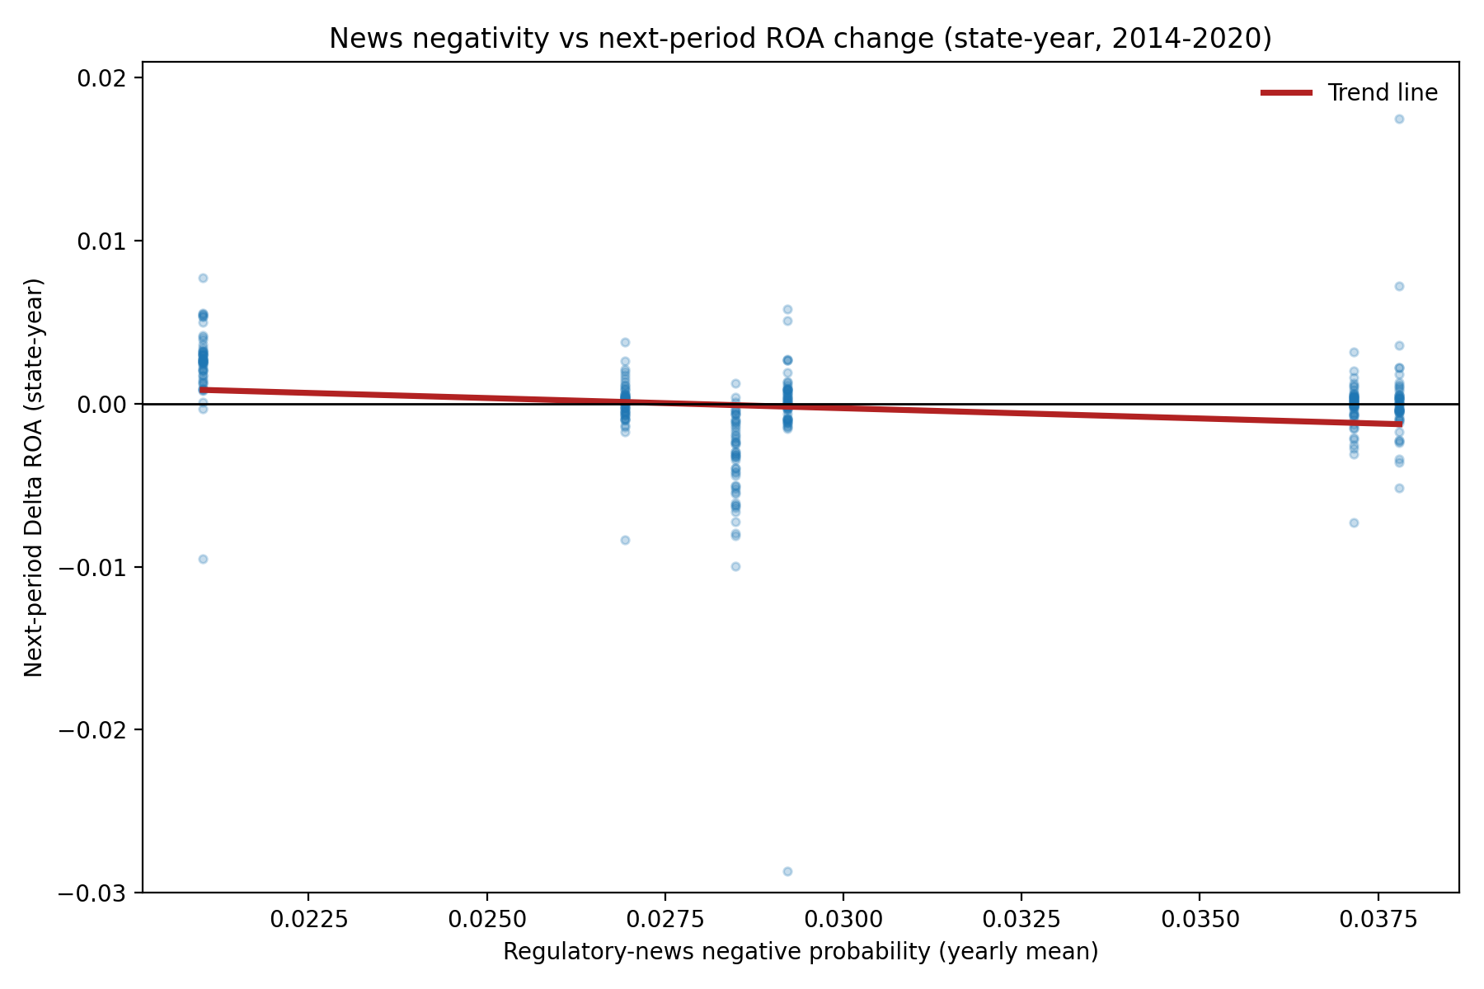
Result 1: Is regulatory news sentiment correlated with changes in bank profitability？
More negative regulatory news sentiment
↓
Predicts / Is associated with
↓
Deterioration in next-period bank profitability (ROA declines)
↓
If this relationship holds
↓ News sentiment may serve as an early warning signal of banking stress
As regulatory news turns more negative
Changes in bank profitability in the following period show a declining trend.
More negative regulatory news sentiment is associated with a higher likelihood of deterioration in next-period bank profitability. This reflects a directional relationship, rather than a strong linear relationship.
Data Analytics and Visualization for Public Policy
6 / 8

Slide 7
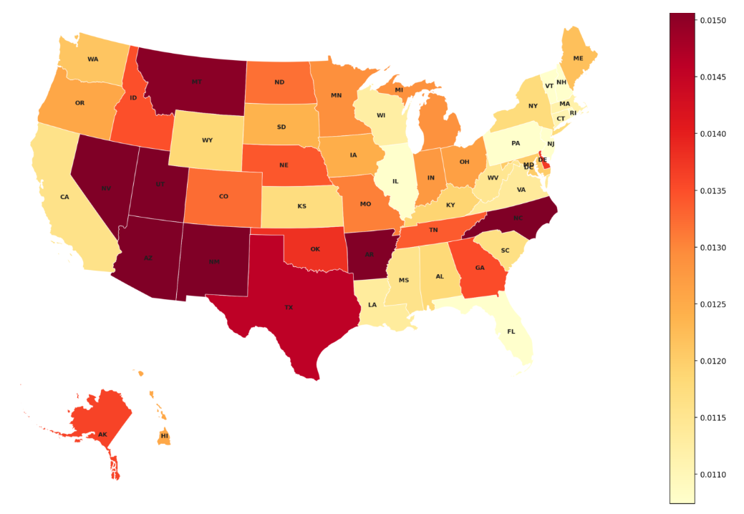
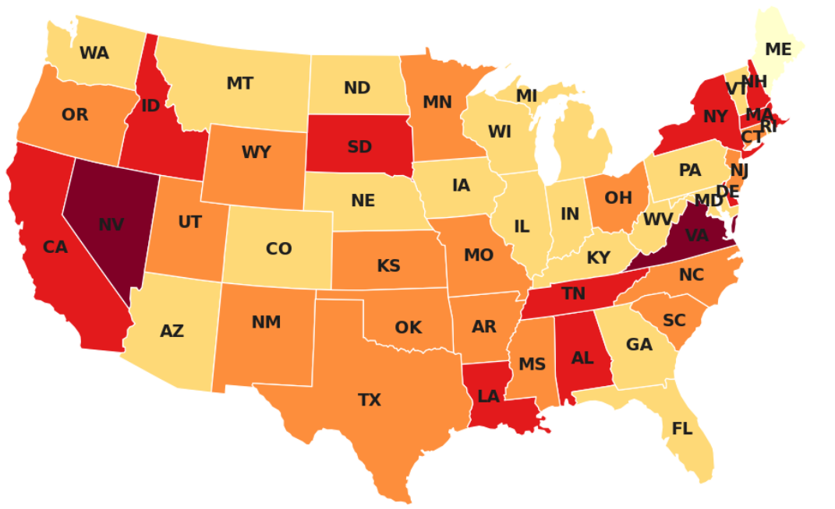

Result 2: Geographic Distribution of Banking Stress
Top Stress States
Most Sentiment-Sensitive States
State | Bad-Year Share | Worst ΔROA
Nevada | 0.71 | -0.0287
Virginia | 0.71 | -0.0064
Delaware | 0.43 | -0.0080
South Dakota | 0.43 | -0.0081
Alabama | 0.43 | -0.0100
State | ΔROA if negative news +10pp
Virginia | -0.0439
Tennessee | -0.0376
South Dakota | -0.0323
South Carolina | -0.0304
Delaware | -0.0279
Nevada and Virginia show the highest frequency of stress years in the sample.
The lagged impact of negative regulatory news on profitability is strongest in VA, TN, SD, and SC, highlighting these states' heightened sensitivity to sentiment shocks.
Data Analytics and Visualization for Public Policy
7/ 8

Slide 8
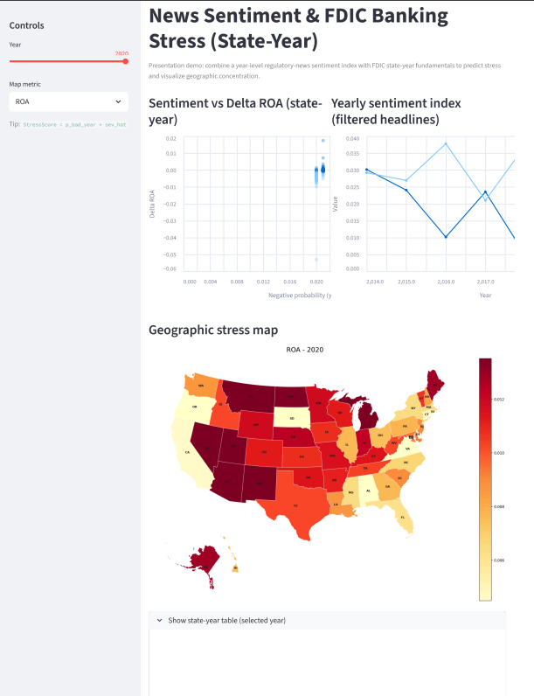
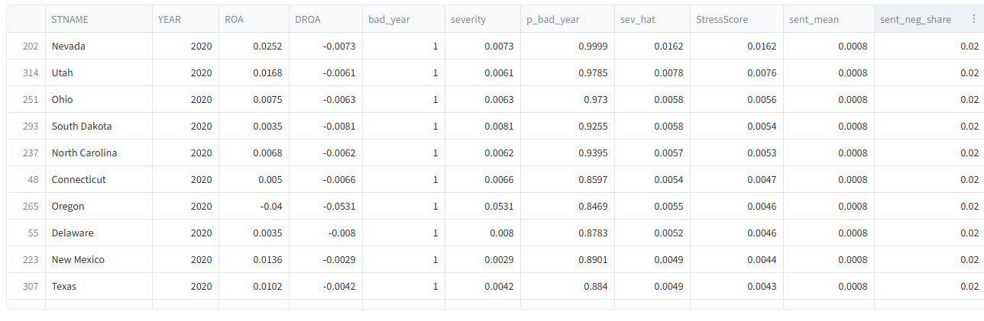
Live Monitoring Dashboard & Key Takeaways
❶ Users can select the year and map metrics for each state on the left panel.
http://localhost:/
❷ The right panel visualizes the relationship between regulatory news sentiment and bank profitability changes.
❸It also shows the geographic distribution of banking stress across states. Interactive charts allow users to explore risk patterns across states.
❹The bottom section displays the corresponding state-level data outputs.
Data Analytics and Visualization for Public Policy
8 / 8

Slide 9
Connection to Policy
Regulatory perspective, not trading
StressScore as a targeting tool under limited attention
Geographic concentration of risk and early intervention
It is not just an ML/LLM prediction exercise, it is also a prototype for how to allocate scarce supervisory resources more intelligently.
Data Analytics and Visualization for PublicPolicy
2 / 8

